Slide 1


ECE 6353
Internet Architectures and Protocols
H. Jonathan Chao
ECE Department
New York University

Slide 2
Why take this course?
Learn the network entry course to advance to several other networking courses offered in the ECE dept
Learn the basics of the networking to prepare yourself to enter networking fields as your career, including:
Video/audio streaming: Netflix, Zoom
Cloud computing: Amazon, Microsoft, Google, Alibaba Cloud, Facebook, ….
5G/6G wireless networks
Augmented reality (AR) and virtual reality (VR)
Remote healthcare and manufacturing automation
Autonomous connected vehicles (ACVs) over 5G
…….
Many job opportunities in networking: IT departments of enterprises, network service providers/vendors, and cloud service providers.

Slide 3
What will you learn from this course?
What is the Internet? What are the architectures?
How does the Internet work?
How does the email work? How does a video stream to your smart phone from thousands of miles away?
How is a cell phone connected to the Internet?
How does an Ethernet network in a campus work?
How do thousands of routers in the Internet work together?
How do my packets find their ways to their destinations on the other side of the globe?
What happens if one of my packets is lost in the network?
What happens if too many people are sending their packets to the network and cause congestion?
………

Slide 4
How to perform well for this course?
Attend every class and lab session
Be focused in the class and understand the content of every lecture as much as you could
Ask questions for the materials you don’t understand in the class or in the office hours (2 different time slots each week)
Review the course material before the next class to get prepared for the quizzes (20% of the total grade)
Submit your lab assignments in time (20% of the total grade)
Try to comprehend the material by understanding the reasoning behind the facts, but not to force yourself to memorize them. In other words, understand more about why/how than what
https://gaia.cs.umass.edu/kurose_ross/about.htm

Slide 5
Roadmap of networking courses
ECE 6353: Internet Architecture and Protocols
ECE 6363: Data Center and Cloud Computing
ECE 6383: High Speed Networks
ECE 7373: High Performance Switches and Routers
ECE 7353: Network Modeling & Analysis
ECE 7363: Communications Networks II: Design and Algorithms
ECE 9383: Network Security

Slide 6
How to select courses for MS study?
DO NOT take courses across many fields, like in your UG study
Focus on 2 at most 3 areas, such as networking, image processing, robotics, AI/ML, hardware/embedded systems, .....
Do projects with professors (3 credits) or MS thesis (6 credits)
Get more hands-on experiences from the labs or projects to make yourself more marketable
Excellent in programming. As CPU/memory technologies keep advancing, many functions can be done with commodity servers (e.g., many services in cloud computing).
You don’t have to be in the computer science department to be good at programming, which is just a tool to help you realize your ideas and systems in the ECE areas.
If you are a hiring manager in the industry, will you hire someone with 4.0 GPA but no hands-on experience, or someone with 3.5 GPA with a lot of hands-on experience?

Slide 7
5G Introduction and Use Cases
H. Jonathan Chao
ECE Department
New York University

Slide 8


Slide 9



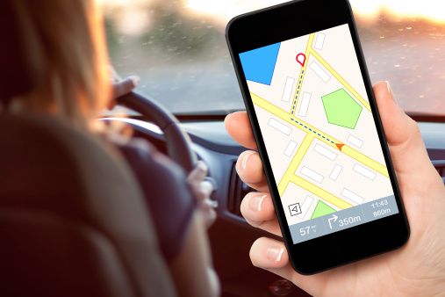


Mobile Internet Anytime & Anywhere
In-building
Outdoor
Walking
Driving
Subway
High-speed train

Slide 10
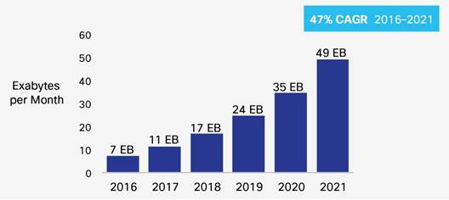
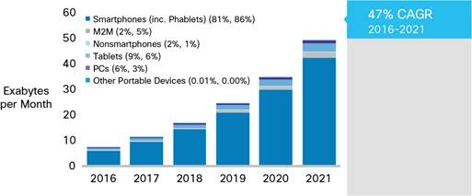
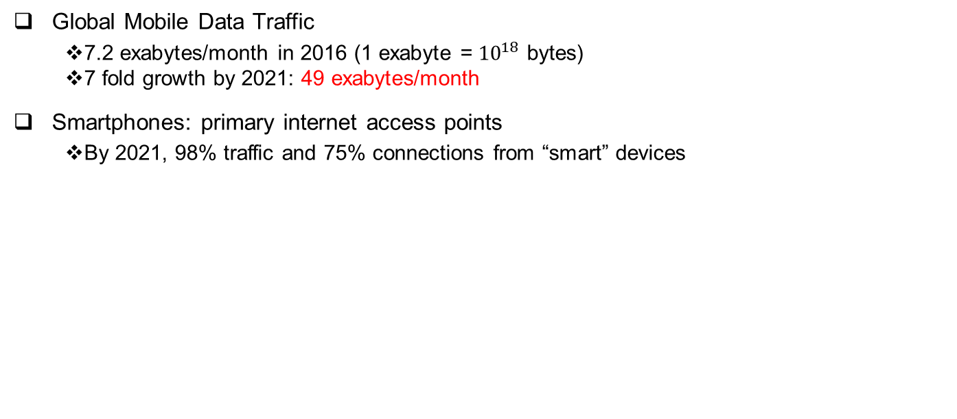
Ubiquitous Mobile Network Services
Global Mobile Data Traffic
7.2 exabytes/month in 2016 (1 exabyte = ${10}^{18}$ bytes)
7 fold growth by 2021: 49 exabytes/month
Smartphones: primary internet access points
By 2021, 98% traffic and 75% connections from “smart” devices
Source: Cisco Visual Networking Index, 2017: Global Mobile Data Traffic Forecast Update, 2016–2021 White Paper

Slide 11
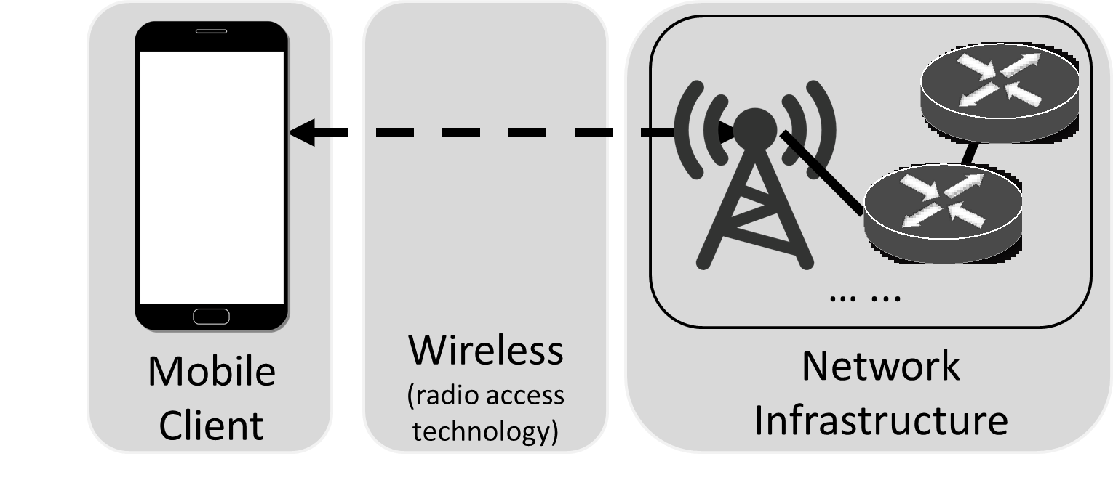

Empowered by Mobile Networks
To connect these smartphones and the Internet, the key enabler is the underlying mobile networked system
Mobile clients first get wireless access to the base stations and then traverse several gateways in the mobile network infrastructure and finally reach the external Internet

Slide 12


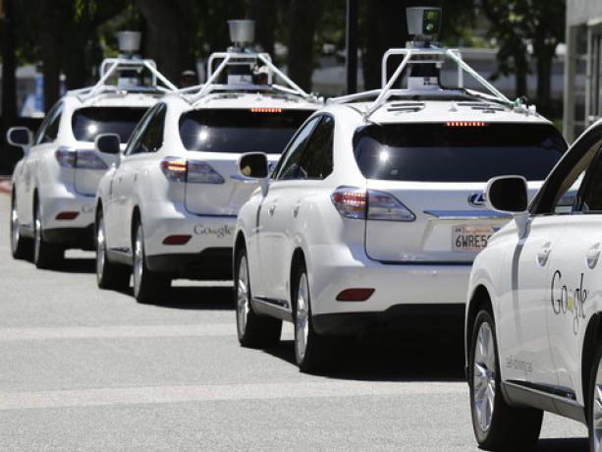


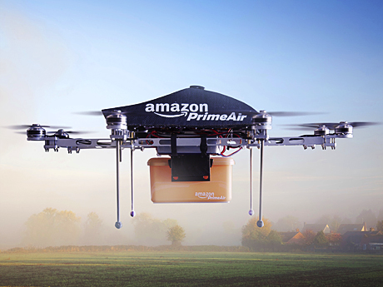
New User Demands in 5G Era
Internet of Things
Tactile Internet
Autonomous Driving
AR/VR
Remote Healthcare
Drone-based Delivery

Slide 13






Mobile Network Evolution
The upcoming 5G is going to offer larger capacity, high speed, low latency, hyper-connectivity and high reliability, and so on
1G 2G 3G 4G 5G
Mid 1980s 1990s 2000s 2010s 2020s
analog
voice
Digital voice
+ Simple data
Mobile
broadband
Mobile Internet
More & faster
Scalable service
anytime and everywhere

Slide 14
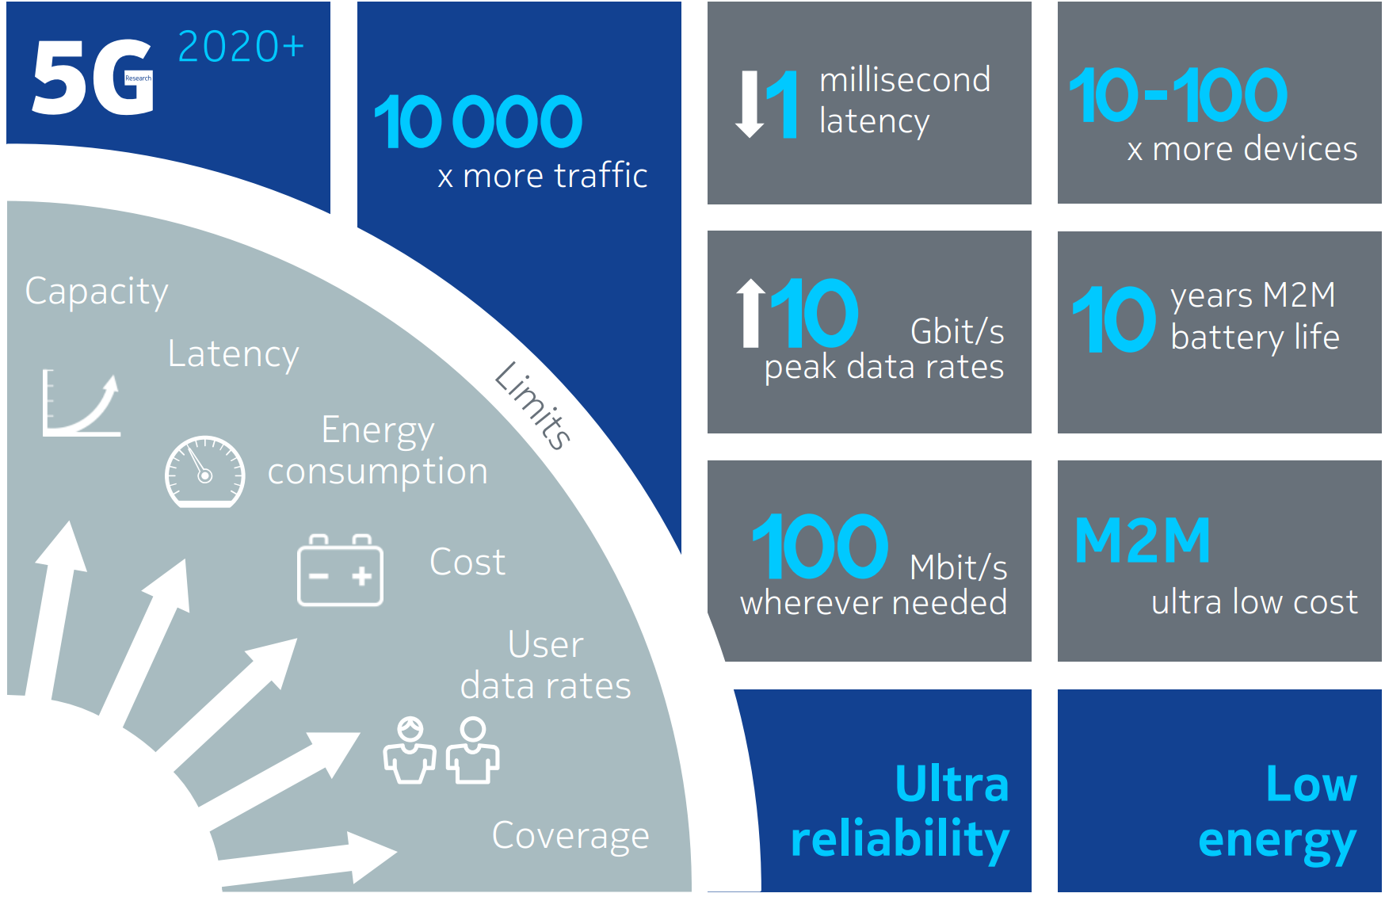
5G Specifications
Source: Nokia, “Looking ahead to 5G: A symbiotic convergence of new and existing technologies”
M2M: Machine to Machine communication

Slide 15










Future Mobile Network Service Dimensions
Network Operations
Low cost operations;
Network Slicing;
Cloud-native
URLLC (Mission Critical Services)
Ultra-Reliable and Low-Latency Communication
$$$$$$/Year/Device; Low latency; Reliability
Massive MTC (IoT)
Massive Machine-Type Communication
$/Year/Device; Low power
eMBB
Evolved Mobile Broadband
$$$/Year/Device; High bandwidth
Vehicular (telemetry, driver assist, autonomous driving, etc.)
$$$/Year/Device; High mobility

Slide 16
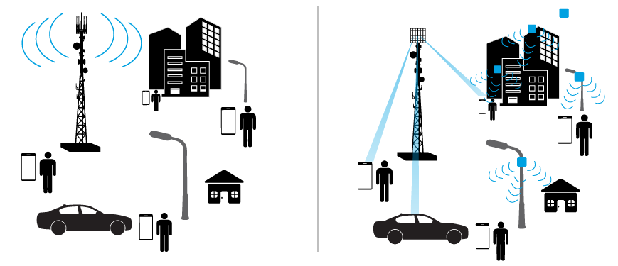
5G Architecture
4G LTE
vs.
5G
Macro Base Station
Macro Base Station
Massive MIMO & Beamforming
Small Cell
MIMO: Multiple-Input Multiple-Output
Source: Qorvo, “Tips and Trends: Small Cell 5G Systems”

Slide 17
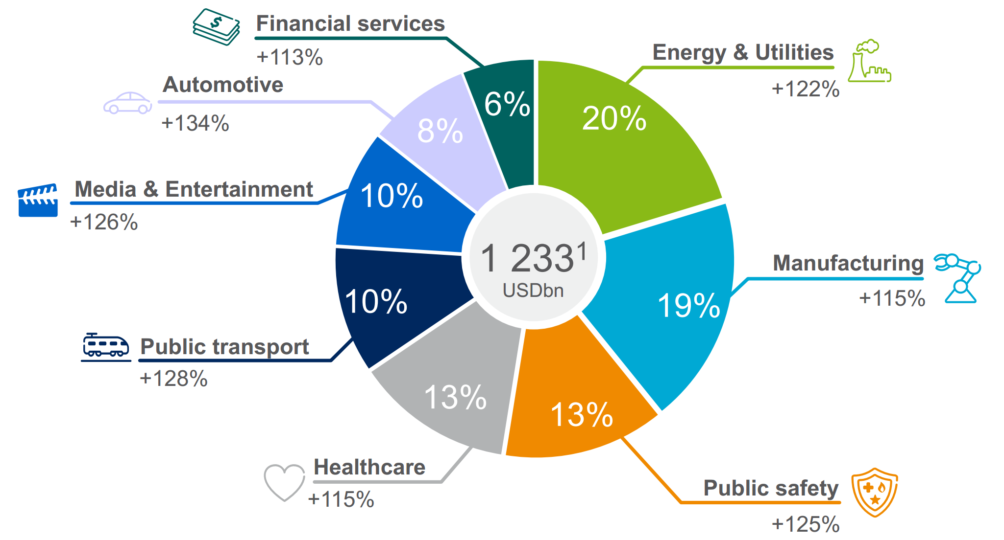
5G Business Potential
5G enabled digitalization revenues in 2026 is about 1.233 trillion dollar!
Source: Ericsson, “5G Business Potential”

Slide 18
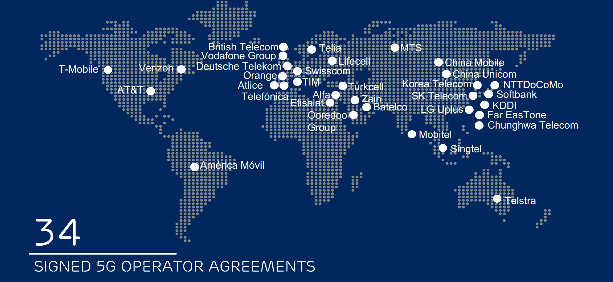
Global 5G Network Operators
Source: Ericsson, “5G Platform Update”

Slide 19
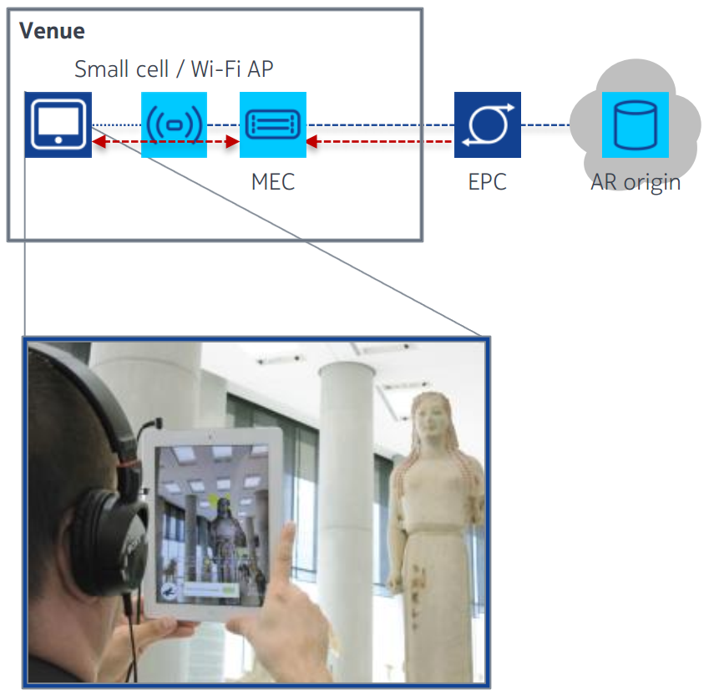
5G in Augmented Reality (AR)
Use Cases
Quickly determine user location based on network data
Edge augmented reality (AR) server performs fast image recognition and subsequent delivery of AR contents
Aggregates all locally relevant AR channels
Benefits
Unique experience with an unmatched degree of interactivity
Ease of discovery and delivery of locally relevant AR content, for instance, the history of a statue at the museum

Slide 20
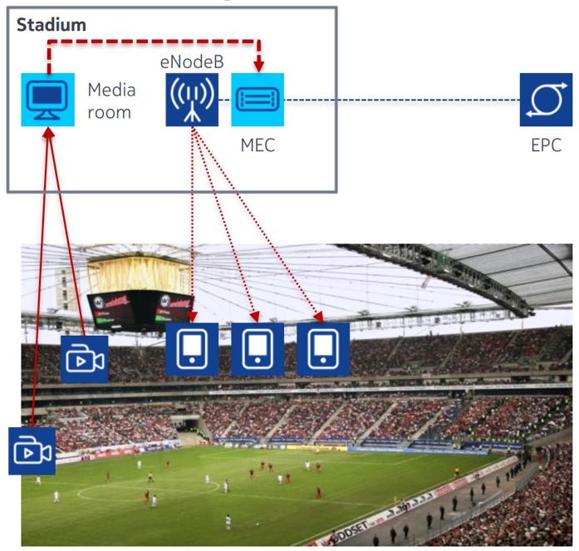
5G in Edge Video Orchestration
Use Cases
Live camera signals are locally ingested and played out to visitors in real time
Visitors can select between different cameras, which are presented in HD and SD quality levels
Benefits
Exciting service for event visitors, providing an immersive real time experience
Minimal delay from camera to device, including encoding, play-out, and decoding
Video traffic does not put any strain on venue backhaul

Slide 21
5G in Manufacturing Automation
5G networks offer manufacturers and telecom operators the chance to build smart factories and take advantage of technologies such as automation, AI, AR for troubleshooting, and IoT.
5G expects to provide low latency, high reliability, high bandwidth and connection density to secure ubiquitous connectivity.
The mobile 5G technology will allow for higher flexibility, lower cost, and shorter lead times for factory floor production reconfiguration, layout changes, and alterations.
A video on “5G enabled manufacturing.”

Slide 22

5G In Healthcare
5G in healthcare will allow the building of infrastructure suitable for the interplay of health sensors, algorithms, and smart devices, for the smooth operation of telemedicine, and telesurgery
5G network can help quickly and reliably transport huge data files of medical imagery to boost remote brain surgeries, connected health, and medical VR
Telesurgery in the 5G era has huge potential to deliver healthcare surgical services to remote locations, a 5G-enabled Tactile Internet (TI)-based telesurgery system for Healthcare

Slide 23


5G-Powered Medical Robot
In January 2019, a doctor in Fujian, removed the liver of a test animal about 30 miles away, the world’s first remote surgery over 5G, which kept the lag time to 0.1 seconds. (video link).
In March 2019, Dr. Ling Zhipei performed the groundbreaking surgery by manipulating instruments in Beijing using a surgery robot powered by China Mobile and Huawei’s 5G network. The patient was at Beijing and suffered from Parkinson’s disease, and doctors at Hainan over 1,500 miles away. The patient received a deep brain stimulation implant during a three-hour procedure.

Slide 24
5G in Autonomous Connected Vehicles
The target for autonomous vehicles involves complete support for communication from Cellular Vehicles to everything (CV2X):
Vehicle-to-Vehicle (V2V) communication
Vehicle-to-Internet (V2I) communication
Vehicle-to-Internet of Things (V2IoT) communication
Software applications coordinate traffic of autonomous motion vehicles on roads
Artificial Intelligence provides real time vision and establishes vehicles' behavior
Autonomous driving infrastructure is making its first appearance in highways – due to deterministic and controllable traffic
Notes:
M. Alberio and G. Parladori, "Innovation in automotive: A challenge for 5G and beyond network," 2017 International Conference of Electrical and Electronic Technologies for Automotive, Torino, 2017, pp. 1-6, doi: 10.23919/EETA.2017.7993223.

Slide 25
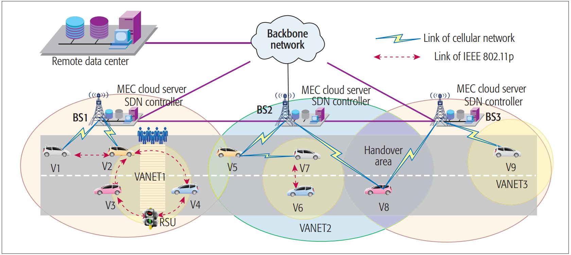
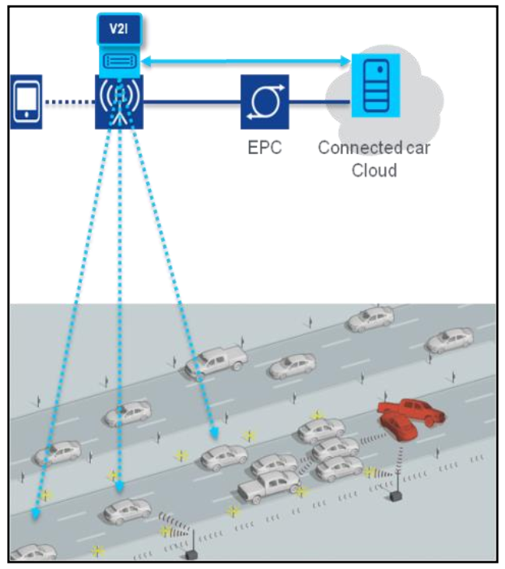
5G in Autonomous Connected Vehicles
5G can provide direct communication between vehicles and satisfy the tight latency requirement
Multi-access Edge Computing (MEC) at 5G base stations can provide the roadside functionality
Receive local messages directly from the vehicles and the roadside sensors
Analyze the messages and propagate hazard warnings with extremely low latency to other cars in the area
RSU: Roadside Unit
VANET: Vehicular Ad hoc Network

Slide 26
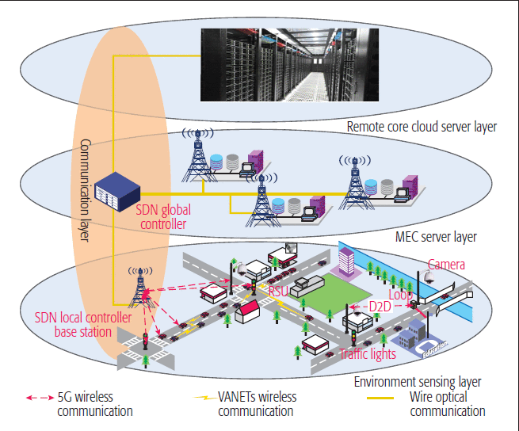
5G in Urban Traffic Management
Numerous high-resolution roadside sensors to sense all real-time traffic conditions – vehicle speed, direction, location, road throughput, weather conditions, and temperature/humidity
Massive traffic data helps guide traffic by making immediate decisions based on traffic prediction algorithms at MEC
Facilitated by different technologies and protocols
SDN – Software Defined Network
MEC – Mobile edge computing
D2D – Device-to-device
VANET – Vehicular Adhoc Network
Notes:
J. Liu et al., "High-Efficiency Urban Traffic Management in Context-Aware Computing and 5G Communication," in IEEE Communications Magazine, vol. 55, no. 1, pp. 34-40, January 2017, doi: 10.1109/MCOM.2017.1600371CM.

Slide 27
Autonomous Vehicle Management in Cyber-Physical Systems
Michael Wang and H. Jonathan Chao
ECE Department
New York University

Slide 28

Need of Autonomous Vehicles
Congestion impact to urban traffic
Each driver spends 54 additional hours per year on the road due to congestion
3.3 billion gallons of fuel wasted
$166 billion loss from traffic congestion
Worsening congestion in 2025
54 hours → 62 hours
3.6 billion gallons of fuel wasted
$200 billion loss from traffic congestion
14%
In 2025

Slide 29

Need of Autonomous Vehicles
Congestion impact to urban traffic
Each driver spends 54 addition hours per year on the road due to congestion
3.3 billion gallons of fuel wasted
$166 billion loss from traffic congestion
Intersections are the keys!!
Worsening congestion in 2025
54 hours → 62 hours
3.6 billion gallons of fuel wasted
$200 billion loss from traffic congestion

Slide 30

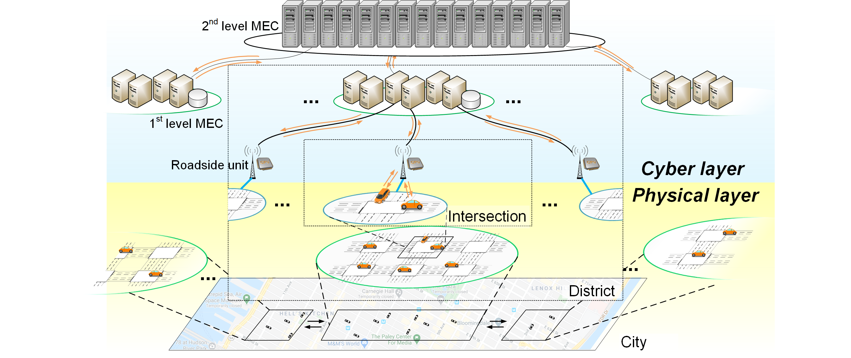
Connected Autonomous Vehicle Management
Intersection Automation
Eliminate traffic lights! Intelligently control each car’s traveling speed.

Slide 31
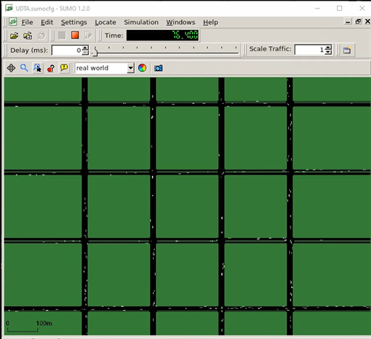
Connected Autonomous Vehicle Management
Intersection Automation
Eliminate traffic lights! Intelligently control each car’s traveling speed.
Traffic-Flow Automation
Minimize congestions! Constantly update each car’s routing path.

Slide 32
Connected Autonomous Vehicle Management
Intersection Automation
Eliminate traffic lights! Intelligently control each car’s traveling speed.
Traffic-Flow Automation
Minimize congestions! Constantly update each car’s routing path.
Network Automation
Guarantee low latency! Flexibly distribute computation tasks and balance the load among multiple nodes.

Slide 33
Connected Autonomous Vehicle Management
Intersection Automation
Eliminate traffic lights! Intelligently control each car’s traveling speed.
Traffic-Flow Automation
Minimize congestions! Constantly update each car’s routing path.
Network Automation
Guarantee low latency! Flexibly distribute computation tasks and balance the load among multiple nodes.

Slide 34

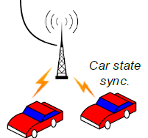
Impact to Urban Traffic Management
12,460 intersections in New York City
82 millions Autonomous Vehicles (AV) in 2030

Slide 35

Demo
Full video demonstration: https://www.youtube.com/watch?v=XrcgsC7Xr6o

Slide 36
Issues of CAV in Cyber-Physical System
Reliability and latency guarantee of communication from CAVs to everything (CV2X)
Denial of Service (DoS) Attacks – DoS refers to non-availability of service that should be available to authorized users. Malicious CAVs can attempt to request for radio resources, to exhaust the available resources, and overburden the controller node (e.g. traffic light) with forged requests. As such, legitimate vehicles cannot get available resources from the controller for their transmission.
Forged Messages – Attacker sends fake information (e.g. vehicle location) to disturb the vehicles route formation. In addition, the attacker is able to imitate artificial traffic or safety location information to confuse connected vehicles.
Notes:
M. Alberio and G. Parladori, "Innovation in automotive: A challenge for 5G and beyond network," 2017 International Conference of Electrical and Electronic Technologies for Automotive, Torino, 2017, pp. 1-6, doi: 10.23919/EETA.2017.7993223.

